Slide 1
UNIT-3 DISTRIBUTED FILE SYSTEM

Slide 2
What is DFS?
A Distributed File System ( DFS ) enables programs to store and access remote files exactly as they do local ones, allowing users to access files from any computer on a network.
The resources on a particular machine are local to itself. Resources on other machines are remote.
A file system provides a service for clients. The server interface is the normal set of file operations: create, read, etc. on files.

Slide 3
Characteristics of (non-distributed) file systems
File systems are mainly responsible for organization, storage, retrieval, naming, sharing and protection of files.
They provide a programming interface that characterizes the file abstraction about the details of storage allocation & layout
Data and Attributes
Data : Sequence of data items used for operations
Attributes :Single record holding information such as length of the file, timestamp, owner’s identity, access control list
Directory: mapping from text names to internal file identifiers.
Metadata : Information stored by file system that is required for file management.
EX: File attributes, directories & all other persistent information

Slide 4
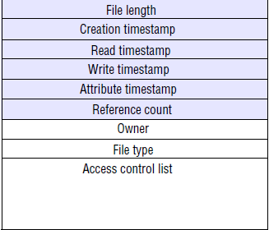
File attribute record structure

Slide 5
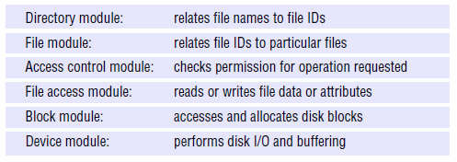
Layered Module structure for the implementation of a non-distributed File System

Slide 6
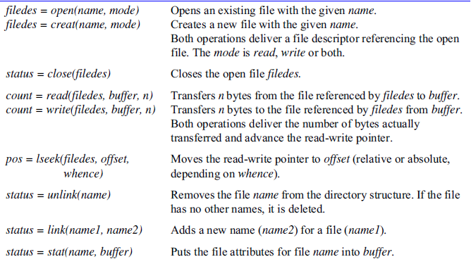
UNIX file system operations

Slide 7
Distributed file system requirements
1.Transparency: Some aspects of Distributed system are hidden from user.
Access: Client pgms can be unaware of distribution of files. Same set of operations are provided for access to remote as well as local files.
Location : Client program should see a uniform name space.
Mobility : Client programs need not change their tables when files are moved to any other location.
Performance : Client program should continue to perform satisfactorily while the load on the service varies.
Scaling : The service can be expanded to deal with wide range of load and network size.

Slide 8
2.Concurrent file updates : Changes to the file by one client should not interfere with the operation of other clients simultaneously accessing or changing the same file.(Concurrency Control)
3.File replication : A file may be represented by several copies of its contents at different locations.
Benefits:
1. Load balancing to enhance the scalability of the service.
2. Enhances the fault tolerance.
4.Hardware and OS heterogeneity : The service interfaces should be defined so that client and server software can be implemented for different operating systems and computers.

Slide 9
5.Fault tolerance : Avoiding failure
To cope with transient communication failures, the design can be based on at-most-once invocation semantics.

Slide 10
6.Consistency : Maintaining the consistency between multiple copies of file.
7.Security: In distributed file systems, there is a need to authenticate client requests so that access control at the server is based on correct user identities and to protect the contents of request and reply messages.
Digital signatures and encryption of secret data is used.
8.Efficiency : A distributed file service should offer facilities that are of at least the same power and generality as those found in conventional file systems and should achieve a comparable level of performance.

Slide 11
File Service architecture
File service is structured as three components,
A flat file service
A directory service
A client module

Slide 12
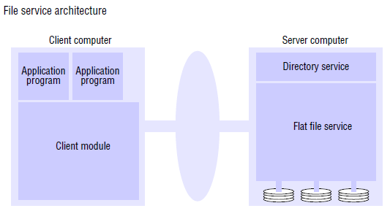

Slide 13
Flat file service
The flat file service is concerned with implementing operations on the contents of files.
Unique file identifiers (UFIDs) are used to refer to files in all requests for flat file service operations.
UFIDs are long sequences of bits chosen so that each file has a UFID that is unique among all of the files.
When the flat file service receives a request to create a file, it generates a new UFID for it and returns the UFID to the requester.

Slide 14
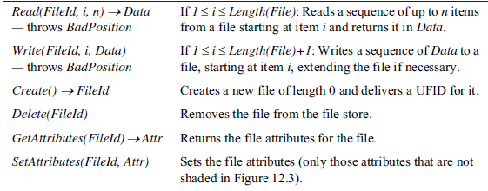
Flat File Service interface

Slide 15
Directory service
The directory service provides a mapping between text names for files and their UFIDs. Clients may obtain the UFID of a file by quoting its text name to the directory service.
The directory service provides the functions needed to generate directories, to add new file names to directories and to obtain UFIDs from directories.
Directory files are stored in files of the flat file service.

Slide 16
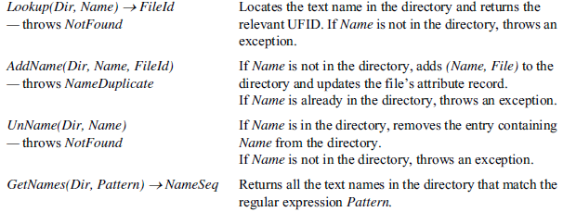
Directory service interface

Slide 17
Client module
A client module runs in each client computer, integrating and extending the operations of the flat file service and the directory service under a single application programming interface that is available to user-level programs in client computers.
The client module also holds information about the network locations of the flat file server and directory server processes.
Achieves satisfactory performance through the implementation of a cache of recently used file blocks at the client.

Slide 18
Access control
In the UNIX file system, the user’s access rights are checked against the access mode (read or write) requested in the open call and the file is opened only if the user has the necessary rights.
In distributed implementations, access rights checks have to be performed at the server.
Issue: if the results of an access rights check were retained at the server and used for future accesses, the server would no longer be stateless.

Slide 19
Two alternative approaches used are:
An access check is made whenever a file name is converted to a UFID, and the results are encoded in the form of a capability, which is returned to the client for submission with subsequent requests.
A user identity is submitted with every client request, and access checks are performed by the server for every file operation.

Slide 20
Hierarchic file system
A tree-structured network of directories is constructed with files at the leaves and directories at the other nodes of the tree.
The root of the tree is a directory with a ‘well-known’ UFID.
A function can be provided in the client module that gets the UFID of a file given its pathname. The function interprets the pathname starting from the root, using Lookup to obtain the UFID of each directory in the path.
In a hierarchic directory service, the file attributes associated with files should include a type field that distinguishes between ordinary files and directories.

Slide 21
File groups
A file group is a collection of files located on a given server.
A server may hold several file groups, and groups can be moved between servers, but a file cannot change the group to which it belongs.
In a distributed file system that supports file groups, the representation of UFIDs includes a file group identifier component, enabling the client module in each client computer to take responsibility for dispatching requests to the server that holds the relevant file group.
Whenever a new file group is created, a unique identifier can be generated by concatenating the 32-bit IP address of the host creating the new group with a 16-bit integer derived from the date, producing a unique 48-bit integer:

Slide 22


